Slide 1
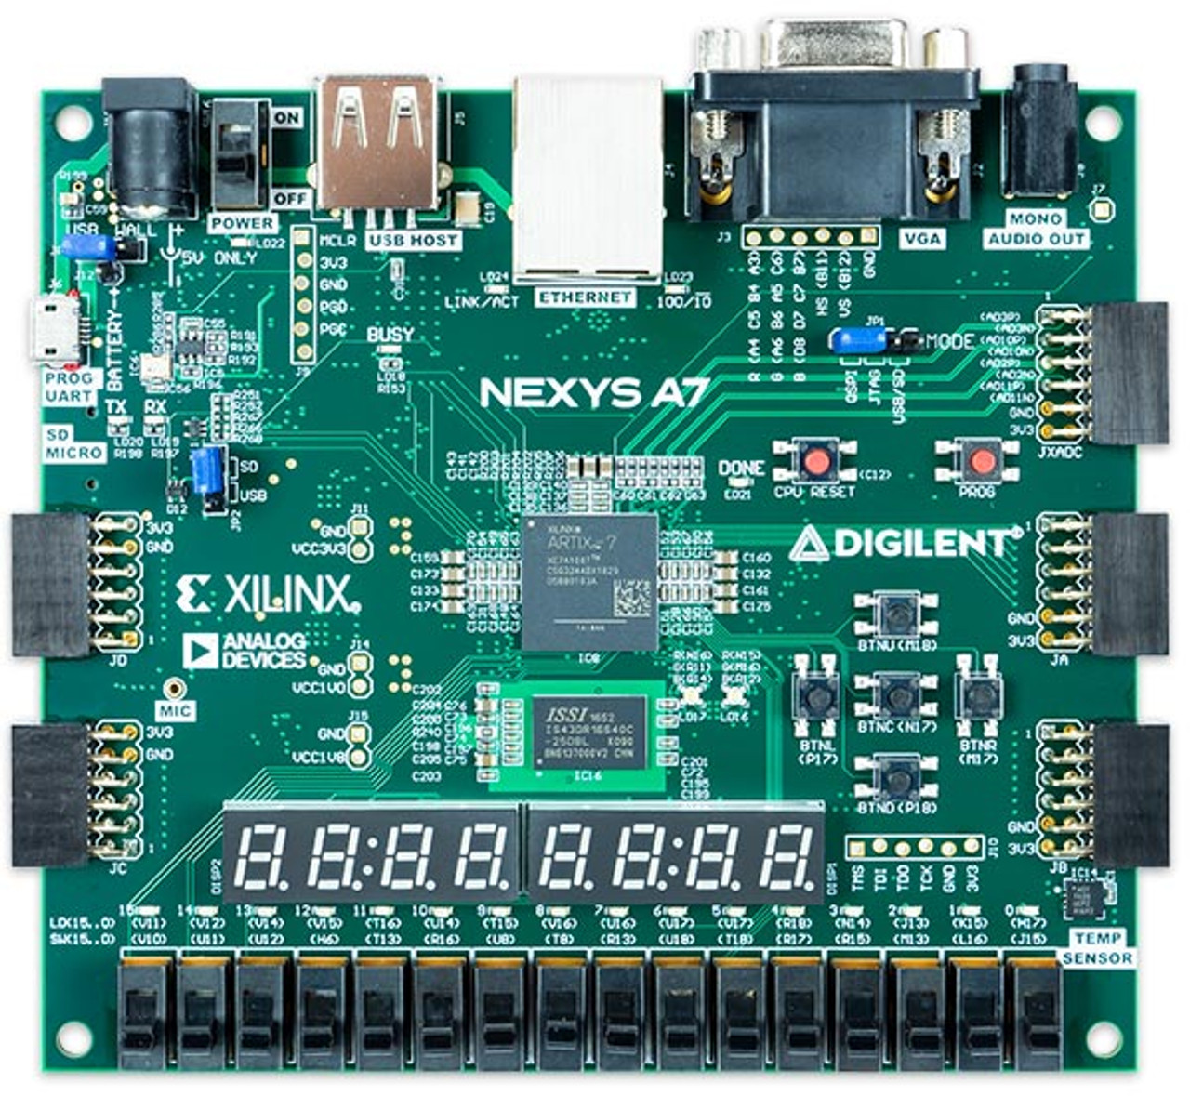
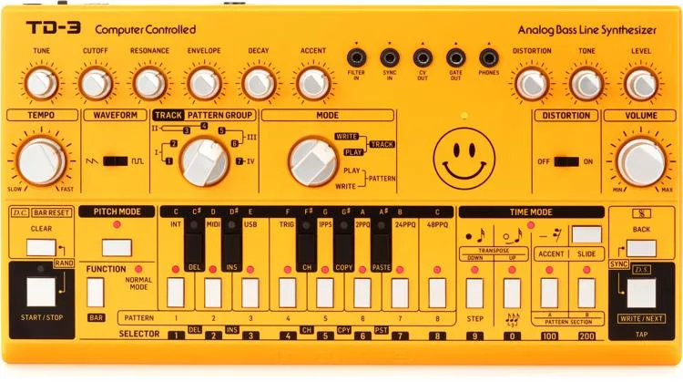
FPGA Synthesizer
and Music Box
Team Nicks +
Nikolas Smith
Nicholas Gutierrez
Xiaopeng Huang
SeokYoung Choi
ENG EC 551 (Fall 2022)
Notes:
Title slide – Project title (tentative), group name (final), team members (final)

Slide 2



Goal/Motivation
Making the music synthesizer & music box using FPGA board
Everyone in the team hasn’t used an audio port of the FPGA before so it would be fun to do a project using it and learn new things
Most of the in-class exercises used 7-seg, switches, buttons, and LEDs etc.
When computer engineers are stressed of their work, they could play music simply download the code to the FPGA board. Our project will bring a peace and quality break to engineers.
Notes:
2. Goal/Motivation –what you are doing and why. This slide should include 1 concrete example of how someone could actually use your design in real life.

Slide 3
(short) Functionality
Verilog code
Nexys A7 FPGA
VGA display
Keyboard input
Speaker output
Notes:
3. Short Functionality – one or two slides max providing a high level overview of the functionality.

Slide 4
(short) Specification
Play musical notes
Implement different octaves
Making chords
Options for choosing different instruments
Play Songs
Verify the musical notes using an instrument tuner
Display keyboard input and open music sheet for songs
Notes:
(requirements)
4. Short Specification – one or two slides max providing an overview specification of the design. What were
the requirements? What did the design have to do?
Keyboard input (chord, notes)
VGA (display)
Music Box (songs. ONOFF switch, buttons)
Speaker
FPGA (7 seg dis, LED)

Slide 5
Detailed Functionality_Verilog Modules
Synthesizer - Top Level Module
Keyboard Input - PS2 data and mapping each keyboard key to music note
Sound Generation - Sine/Square wave generation, note duration
Music Box Memory - 4 songs stored in memory, selected by pressing one of the four buttons on the FPGA
VGA - Display current Music Output Mode, current note being played, and snippets of the four songs in the music box
Notes:
5. Detailed Functionality – break down in more detail how your design worked. This should be sufficiently detailed but NOT just static shots of Verilog code! Help us understand why this is worthy of 40% of your grade!
1-5 seok

Slide 6
Detailed Functionality_Generating Sounds
Sine Waves (Keyboard Input):
Clock divided by 16 to create adjustable duty cycle
Sine wave output determines duty cycle for next cycle
Multiple inputs combined to make chords
Square Waves (Music Box):
Sound Frequency = [ (Board Frequency) / (Note Frequency) ] / 2
All values must be rounded to the nearest whole number
The resulting sound is the middle value found from the frequency, so higher frequency = higher note
Notes:
5. Detailed Functionality – break down in more detail how your design worked. This should be sufficiently detailed but NOT just static shots of Verilog code! Help us understand why this is worthy of 40% of your grade! Nik and Nick

Slide 7
Detailed Functionality_Music Box
The musicBox switch is flipped to put the FPGA in Music Box Mode with a BPM of 100
All four songs are stored in a memory reg array in the form of instructions
Based on what button is pressed, the memLoc is set to the starting position of that song in the memory
Each instruction includes a 5 bit notecase (mapped to the 20’bit clk divider value) and a 2 bit duration value
The duration indicates how many positive edges the duration clkDivider should hit before turning off the music for one beat
The music box will iterate through these instructions until a 0 instruction is hit, where it will then wait for another button to be pressed
List of songs: Twinkle Twinkle Little Star, Old MacDonald Had a Farm, Ode To Joy, and Jasmine Flower
Notes:
5. Detailed Functionality – break down in more detail how your design worked. This should be sufficiently detailed but NOT just static shots of Verilog code! Help us understand why this is worthy of 40% of your grade!
Nick

Slide 8
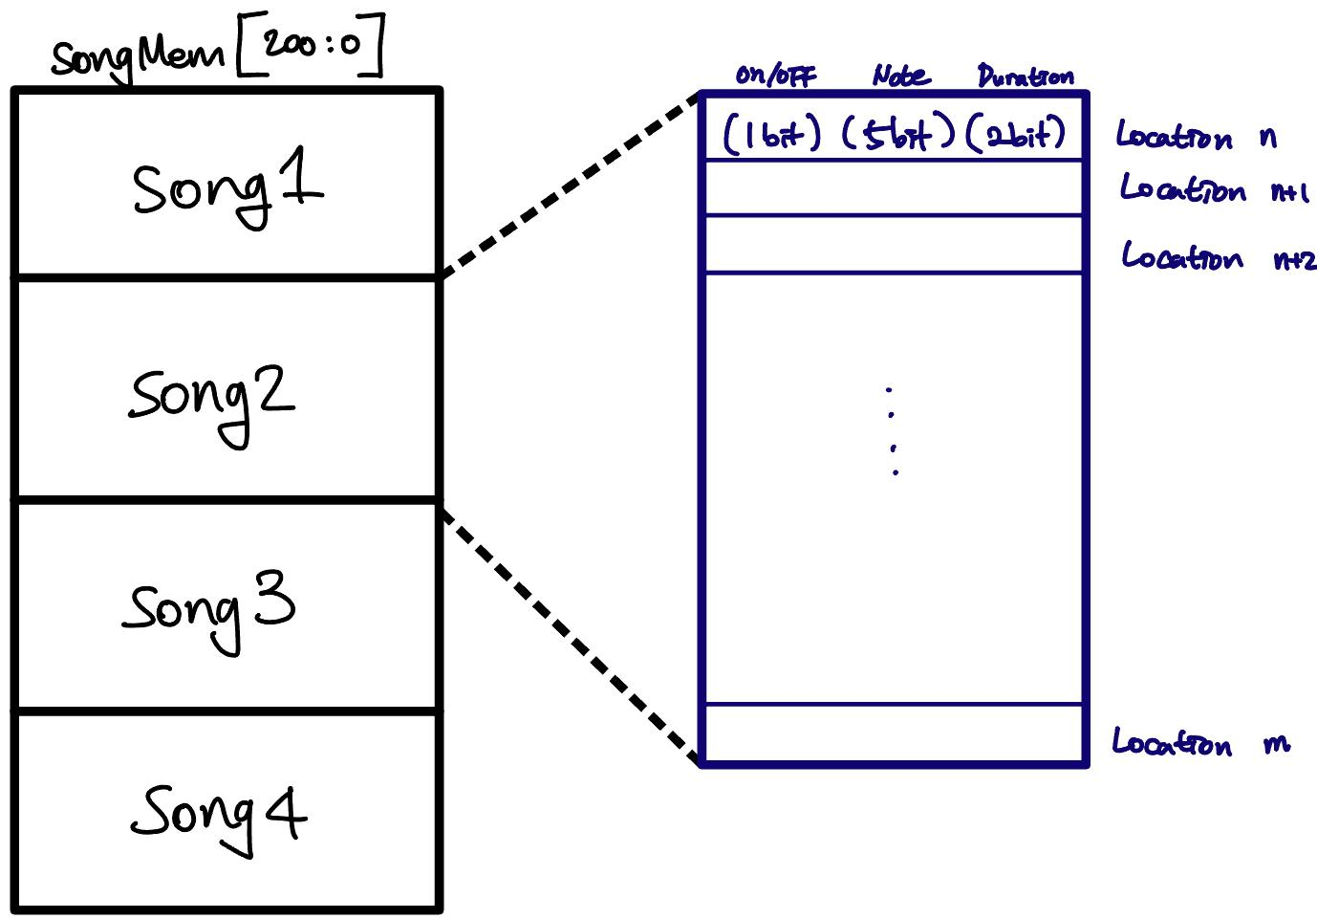
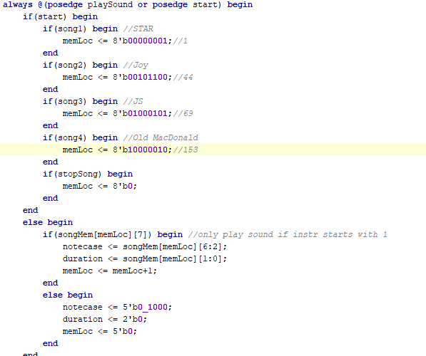
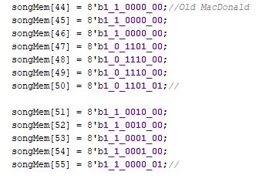
Notes:
Nick

Slide 9
Detailed Functionality_VGA
Display music note input by user
Mapped by corresponding keystroke
Musical sheet examples
Guide users to play with the notes
Mode indicator
USER INPUT or MUSIC BOX
Notes:
5. Detailed Functionality – break down in more detail how your design worked. This should be sufficiently detailed but NOT just static shots of Verilog code! Help us understand why this is worthy of 40% of your grade!
Xiaopeng H

Slide 10
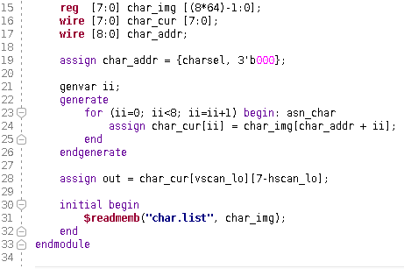
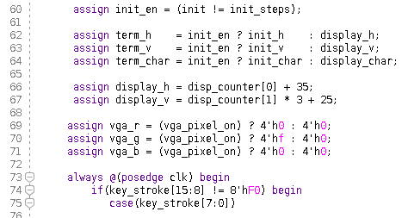
HS
VS
vga_h_ctr
vga
clk
vga_controller_640_60
vga_v_ctr
vga_r
vga_g
music_box_mode
vga_b
key_stroke
term_h term_v
pixel_on
term_char
font_terminal
addr
data
char_ROM
Notes:
Xiaopeng H

Slide 11
Detailed Functionality_FPGA
Speaker / Keyboard / VGA connected to the board
Keyboard input (default) mode
Music box mode
A switch that changes to a music box
Each button (N, W, S, E) plays a song
Middle button stops a song
Notes:
5. Detailed Functionality – break down in more detail how your design worked. This should be sufficiently detailed but NOT just static shots of Verilog code! Help us understand why this is worthy of 40% of your grade!
seok

Slide 12
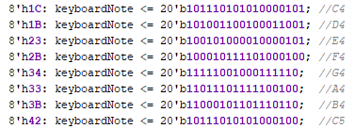
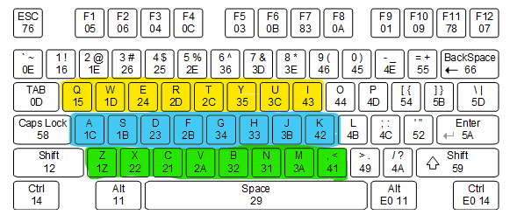
Detailed Functionality_Keyboard Input
Set the note to the 20 bit sound frequency
corresponding to the keyboard hex value for the square wave
Sound Frequency = [ (Board Frequency) / (Note Frequency) ] / 2
Three octaves
C3 - C4: starting from Q
C4 - C5: starting from A
C5 - C6: starting from Z
PS2 Receiver and Debouncer
Notes:
5. Detailed Functionality – break down in more detail how your design worked. This should be sufficiently detailed but NOT just static shots of Verilog code! Help us understand why this is worthy of 40% of your grade!
seok

Slide 13
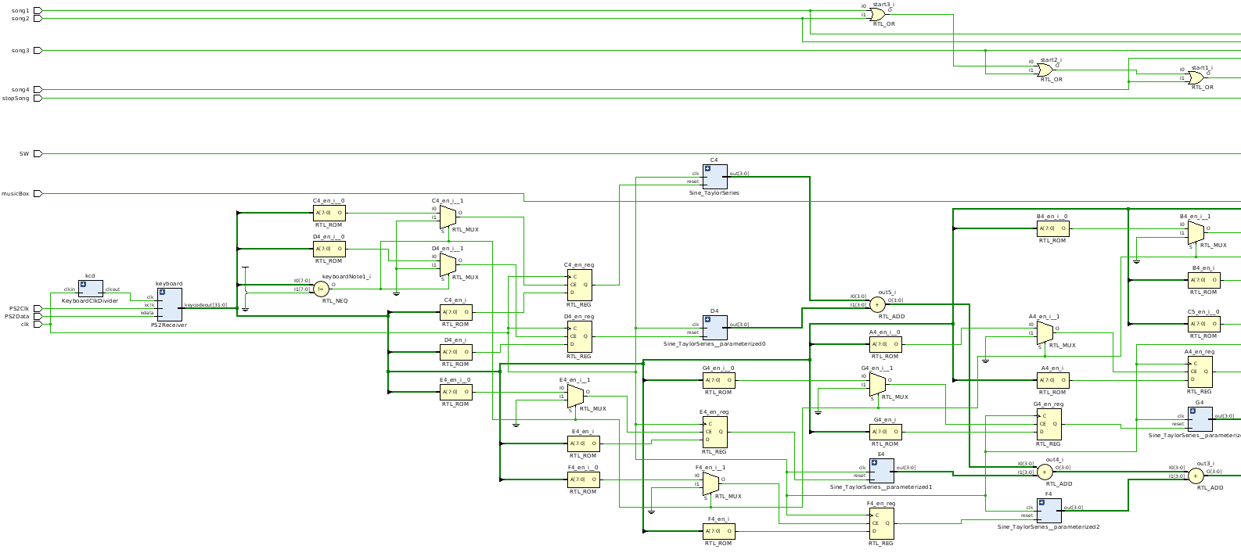
Verilog RTL Diagrams
Notes:
6. Detailed Block Diagrams – provide the real block diagrams for your design. You can weave these in with #5.

Slide 14
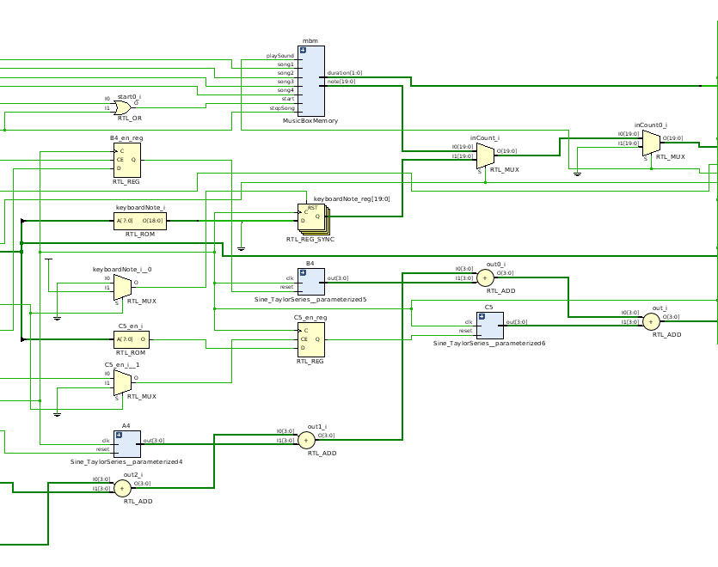

Slide 15
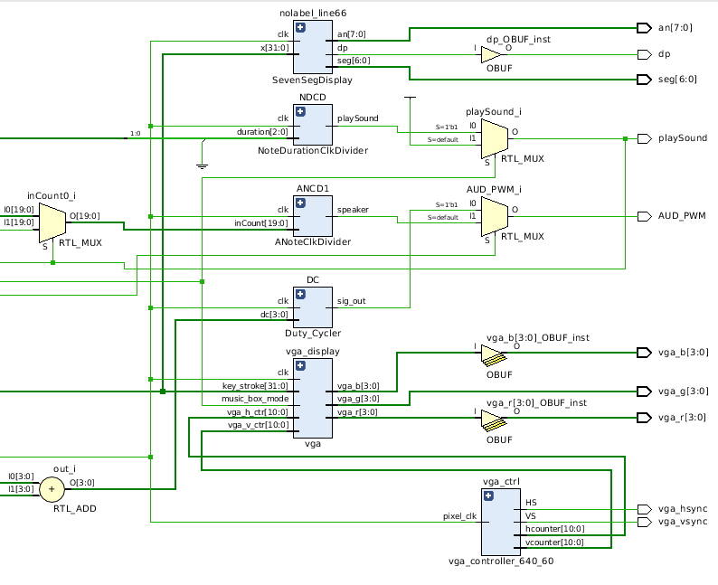

Slide 16
Block Diagrams
MusicBox Switch
Keyboard Output
FPGA
User Input
Note Clock Divider
Music Note Output
Mux
MusicBox
Memory Output
Duration
Notes:
6. Detailed Block Diagrams – provide the real block diagrams for your design. You can weave these in with #5.Nick

Slide 17
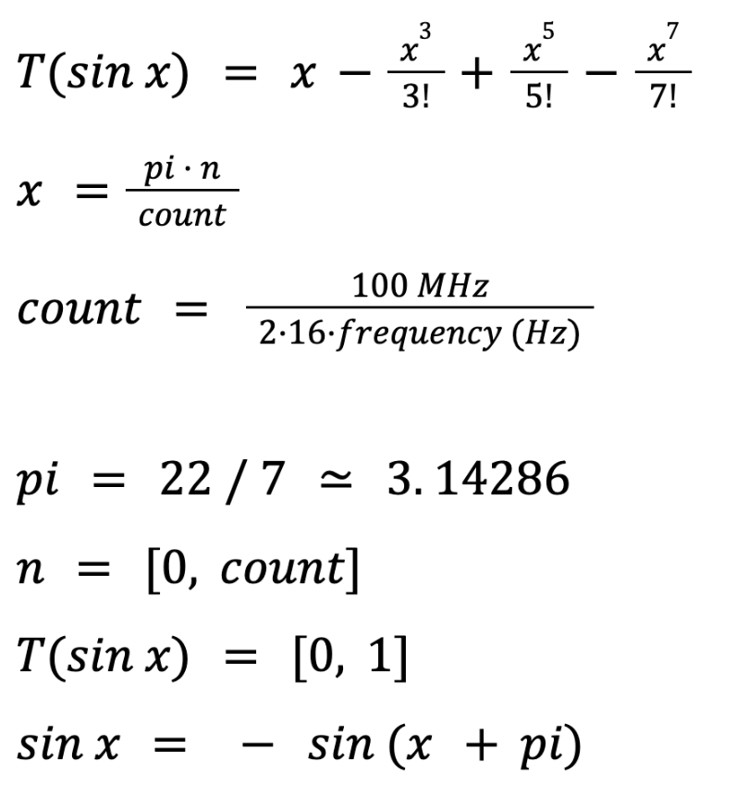
Taylor Series
Notes:
Nik
T(sinx) = x - (x^3)/3! + (x^5)/5! - (x^7)/7!
X = pi*n/count
count = 100MHz/(2*16*f(Hz))
pi = 22/7
n = [0, count]
T(sinx) = [0, 1]
sinx = -sin(x+pi)

Slide 18
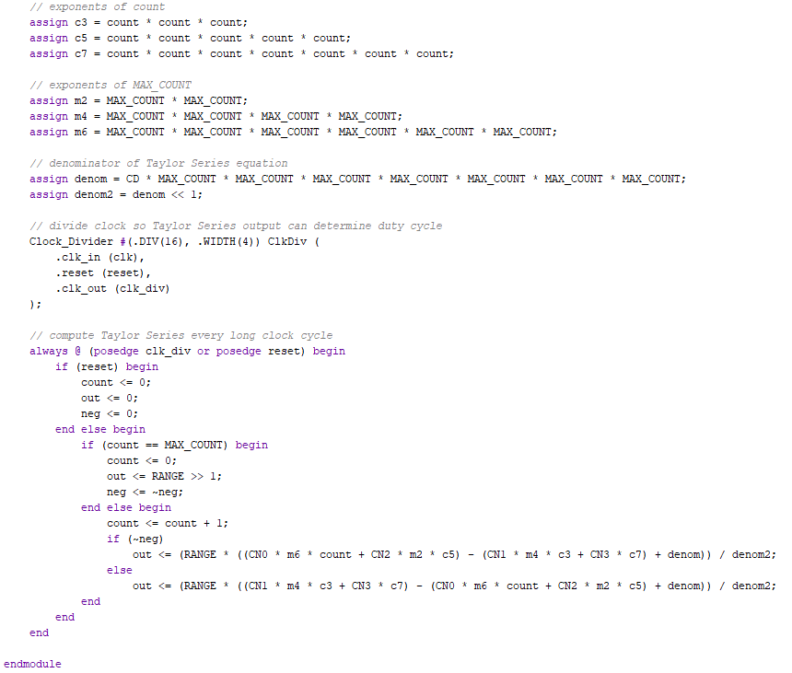
Verilog example
Module to generate sine waves
Taylor Series approx. to 4 terms (accurate for half period)
First half is positive TS approx. and other half negative
Input in range 0-10⁸/32f
Output in range 0-5 for combination of signals
Notes:
7. One clear Verilog example – This should be the Verilog you are most proud of. Explain to us how it works. Nik

Slide 19

Successes
Generates musical notes
Current notes C3~C6, 3 octaves. we could do as many as we want
Square waves/sine waves
Verification through an instrument tuner
Making chords
Pressing multiple keyboards up to three works
Able to play songs; our backup plan
Four songs stored in each button
The middle button implemented to stop the song
VGA display
Able to see the user input in real time
Musical sheet corresponding to the keystroke
Notes:
8. Successes – discuss how your project was successful and why.
Xiaopeng

Slide 20

Failures
Multi-instrument synthesizer
Finding the right values for music notes sound waves was very difficult and will require too much time
Spend more time on figuring out harmonics and sine wave generation
Need extra DAC to simulate timber of different instruments
Pressing different key rapidly does not work
Second Input is not detected right way if pressed faster than 0.1 sec
Work more with keyboard clock to try to get faster input detection
Notes:
9. Failures – discuss how your project did not work out as you planned. Provide examples of what you would do differently.
Nick

Slide 21
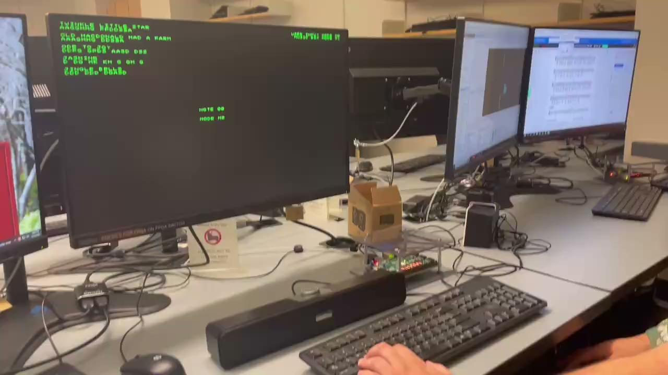

Short Demo Videos
Check the primary video on YouTube for more details.
Notes:
It will have to be very short (~1 to 2 minutes)

Slide 22
Short Demo Videos
Check the primary video on YouTube for more details.
Notes:
It will have to be very short (~1 to 2 minutes)

Slide 23
Attribution of Work
Nick Gutierrez - Square Wave Sound Generation and Music Box
Nik Smith: Sine wave generation and chords
SeokYoung Choi: Music box, keyboard input
Xiaopeng Huang: VGA display for the system
Notes:
It will have to be very short (~1 to 2 minutes)

Slide 24
Questions?

